Slide 1
3D Modelling Transform
Amartya Kundu
Lecturer, CSE, UGV

Slide 2
3D Transformations
Basics of 3D geometry
Basic 3D Transformations
Composite Transformations

Slide 3
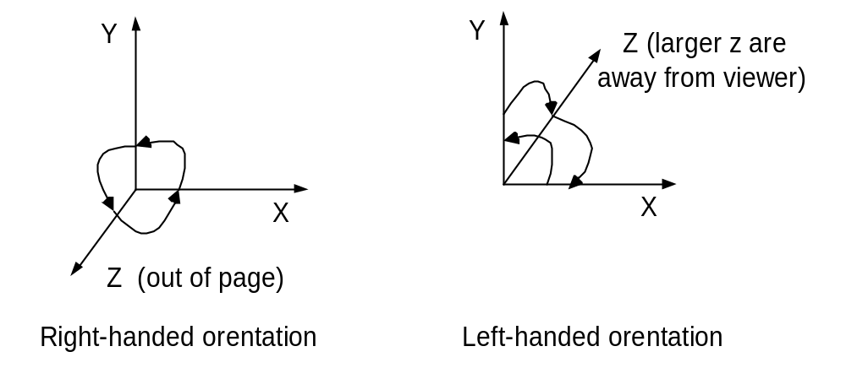
Orientation
Right-hand orientation
Left-hand orientation

Slide 4

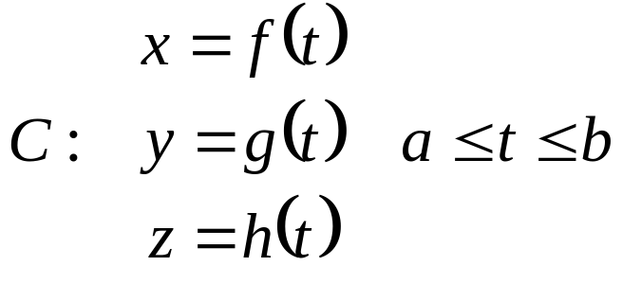
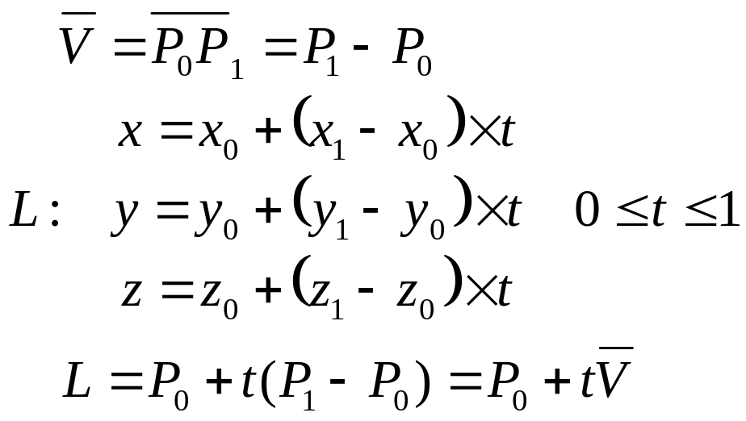
3D Equation of Curve & Line
Curve
  Non-Parametric form
  Parametric form
Line
z
C
y
x
t =1
t > 1
t = 0
0 < t < 1
P₁(x₁,y₁,z₁)
V
t < 0
P₀(x₀,y₀,z₀)

Slide 5
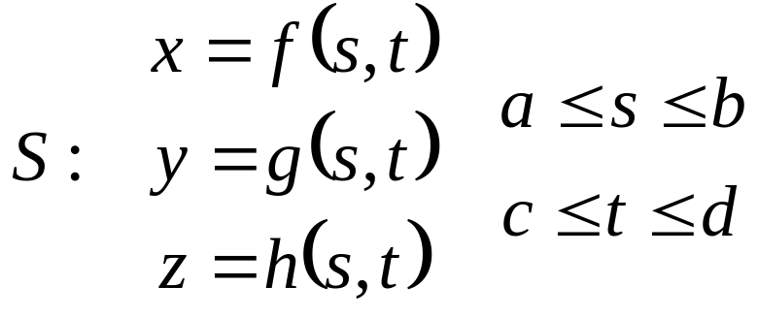
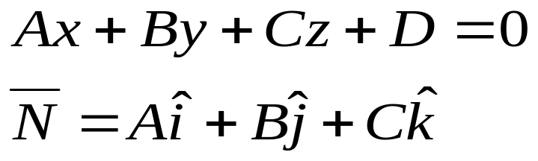
3D Equation of Surface & Plane
Parametric equations of Surface & Plane
Surface
Plane : with Normal, N
N
P₀

Slide 6
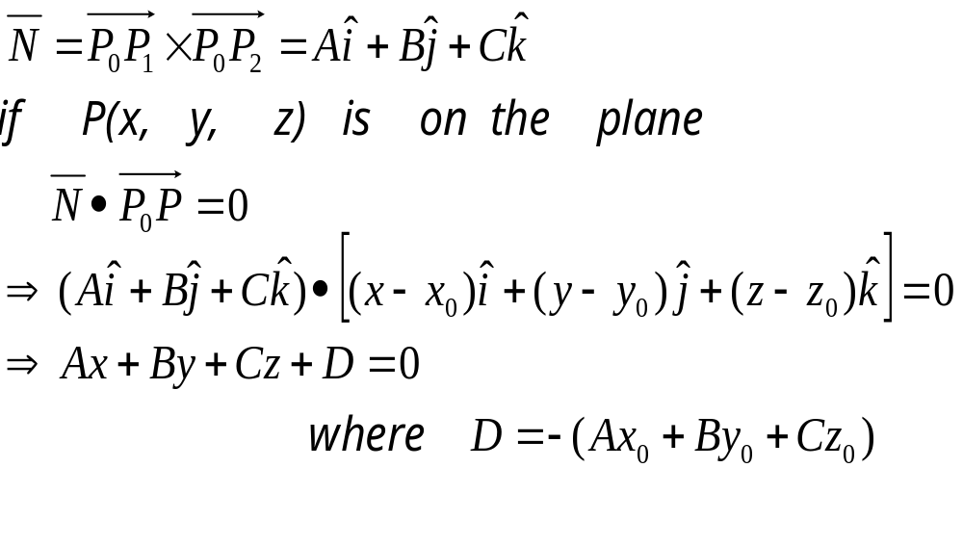
3D Plane
Ways of defining a plane
1. 3 points P₀, P₁, P₂ on the plane
2. Plane Normal N & P₀ on plane
3. Plane Normal N & a vector V on the plane
Plane Passing through P₀, P₁, P₂
N
P₀
P₂
V
P₁

Slide 7
Vectors in 3D
Have length and direction
V = [a ,b , c]
Length is given by the Euclidean Norm
|V| = √( a² + b² + c² )
Dot Product
V • U = [x_{v}, y_{v}, z_{v}]•[x_{u}, y_{u}, z_{u}]
= x_{v}*x_{u} + y_{v}*y_{u} + z_{v}*z_{u}
= |V| |U| cos ß
Cross Product
V × U
= [y_{v}*z_{u} - z_{v} y_{u} , -x_{v}*z_{u} + z_{v}*x_{u} , x_{v}*y_{u} – y_{v}*x_{u} ]
= η |V| |U| sin ß
V × U = - ( U x V)
z
V=aI+bJ+cK
(a,b,c)
y
x

Slide 8
Vector Equation of Line
A line is defined by
  A direction vector V
  A point P₀(x₀,y₀,z₀)
z
V
P₀(x₀,y₀,z₀)
P(x,y,z)
y
x

Slide 9
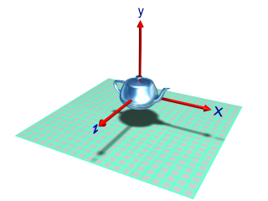
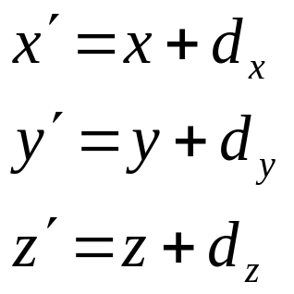
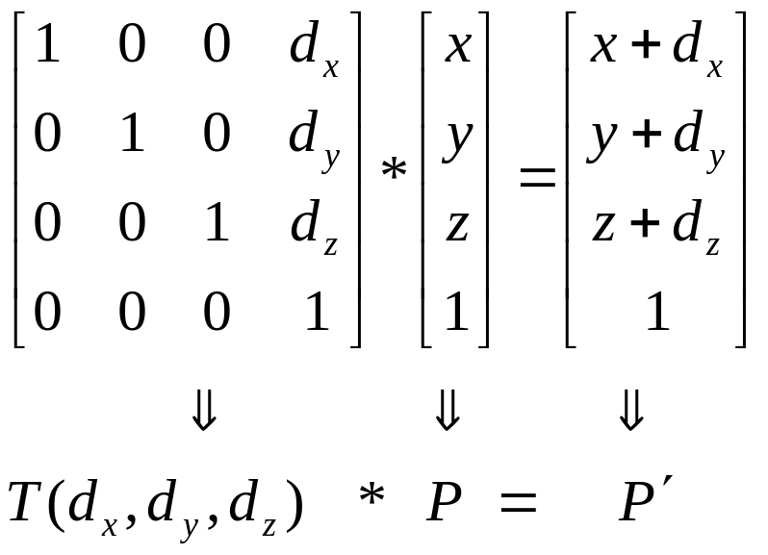
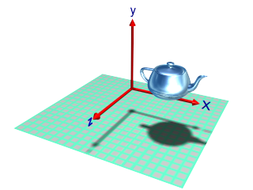
Translation – 3D

Slide 10
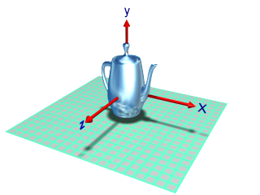
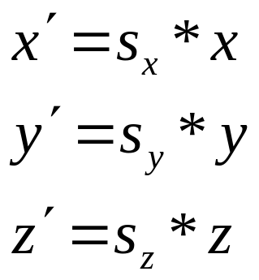
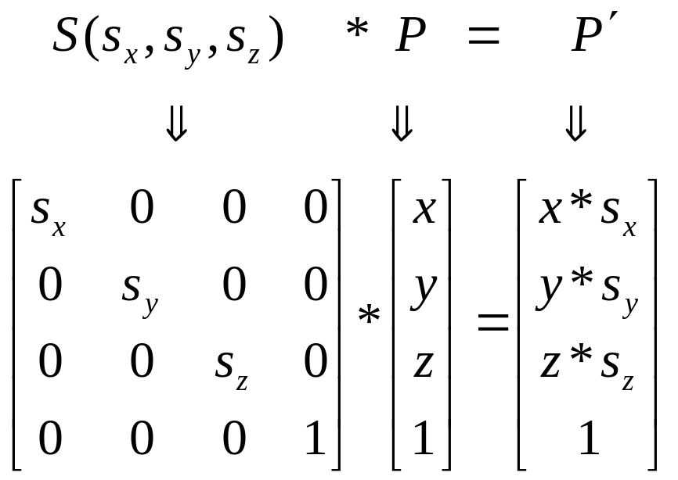
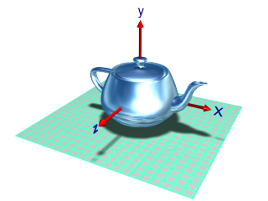
Scaling – 3D
Original
scale Y axis
scale all axes

Slide 11
Rotation in 3D
y
For 3D-Rotation 2 parameters are needed
  Angle of rotation
  Axis of rotation
Rotation about y axis
P( x’, y’=y, z’ )
P(x,y,z)
ϕ
x
z = r cosϕ
θ
z’ = r cos(ϕ+θ)
x’ = r sin(ϕ +θ)
x = r sinϕ
z

Slide 12
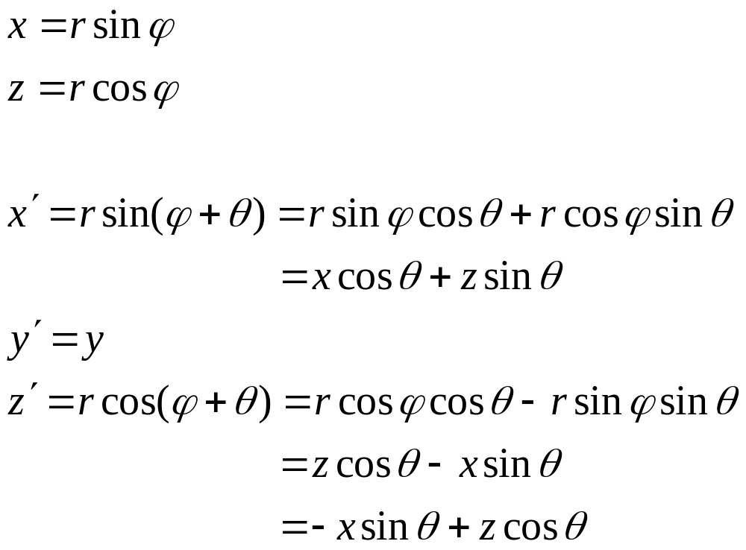
Rotation in 3D

Slide 13
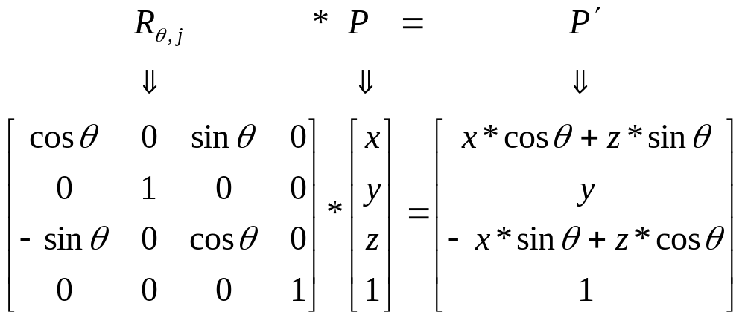
Rotation in 3D
About y-axis

Slide 14
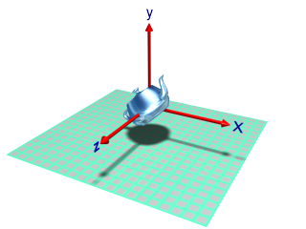
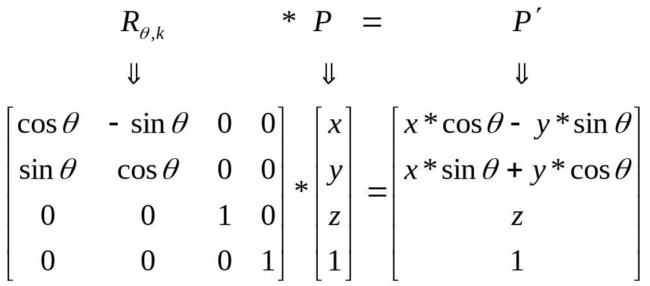
Rotation – 3D
Rotation about z-axis:

Slide 15
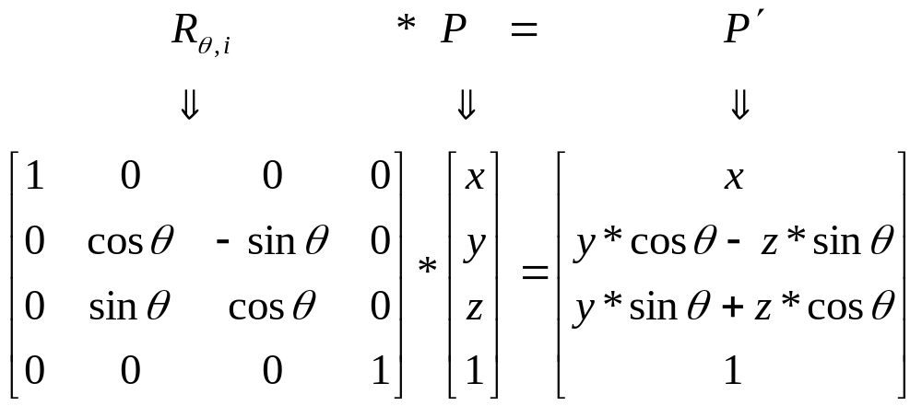
Rotation about X-axis
About x-axis

Slide 16
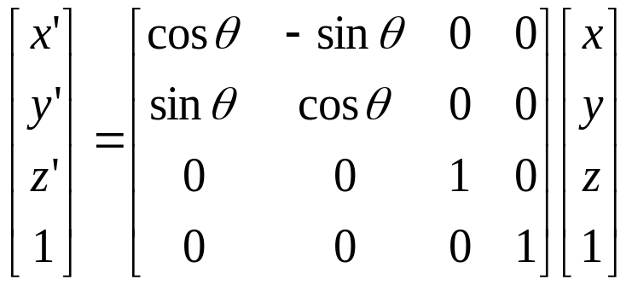
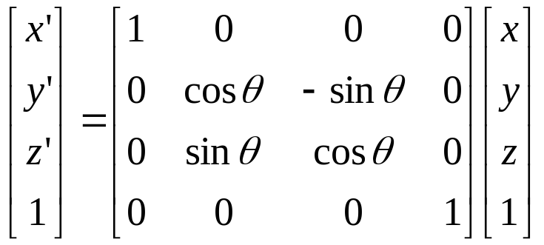
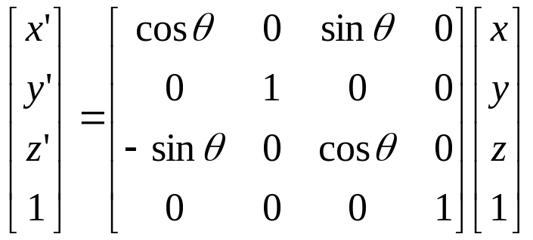
Coordinate-Axes Rotations
Z-Axis Rotation
Y-Axis Rotation
y
y
z
x
x
z
X-Axis Rotation
y
x
z

Slide 17
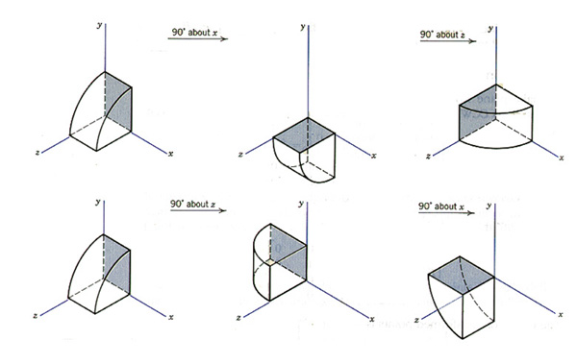
Order of Rotations
Order of Rotation Affects Final Position
  X-axis ➔ Z-axis
  Z-axis ➔ X-axis

Slide 18
Object Transformation
Line: Can be transformed by transforming the end points
Plane:(described by 3-points) Can be transformed by transforming the 3-points
Plane:(described by a point and Normal) Point is transformed as usual. Special treatment is needed for transforming Normal

Slide 19
Transforming Normal Vector
Let the
plan
be represented
by
point
P
and
normal
N
[
]
[
]
N
=
A
B
C
D
T
and
P
=
x
y
z
1
T
such that
N
T
∗
P
=
Ax
+
By
+
Cz
+
D
=
0
Let
M
be
the
transform
ation to
be
applyed
on
P
and
Q
be
a
transform
ation
such that
(
Q
∗
N
)
T
∗
M
∗
P
=
0
Q
T
∗
M
=
I
which
leads
to
N
T
∗
Q
T
∗
M
∗
P
=
0
∴
Q
T
=
M
−
1
∴
N
′
=
(
M
−
1
)
T
∗
N

Slide 20
Composite Transformations – 3D
Some of the composite transformations to be studied are:
  Relative Scaling
  A_{V,N} = aligning a vector V with a vector N
  R_{θ,L} = rotation about an axis L( V, P )
  S_{sx,sy,P}= scaling w.r.t. point P

Slide 21
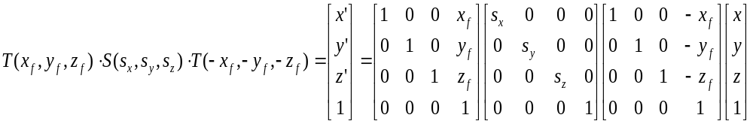
Relative Scaling
Scaling with a Selected Fixed Position
y
y
y
y
z
x
z
x
z
x
z
x
Original position
Translate
Scaling
Inverse Translate

Slide 22
Av: Aligning vector V with k
z
(a,0,√(b²+c²))
(a,b,c)
(√(a²+b²),0,c)
V
y
x

Slide 23
Av: Aligning vector V with k
z
(0,0, λ)
(0,0,c)
(0,b,c)
(a,0, λ)
(a,b,c)
θ
λ
θ
|V|
y
λ=√(b²+c²)
x

Slide 24
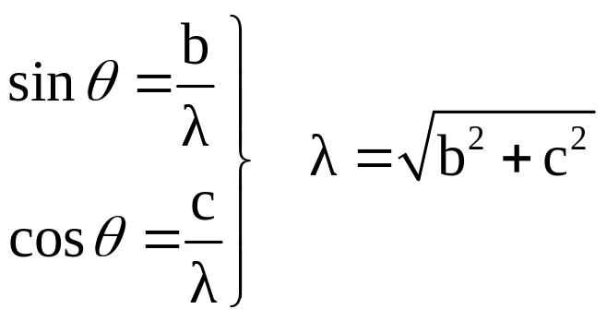
A_{V} : aligning vector V with k
z
Step 1: Rotate about x-axis by θ
(0,0, λ)
b
(0,b,c)
(a,0, λ)
c
λ=√(b²+c²)
(a,b,c)
θ
λ
θ
|V|
y
A_{v} =
R_{θ,i}
x

Slide 25
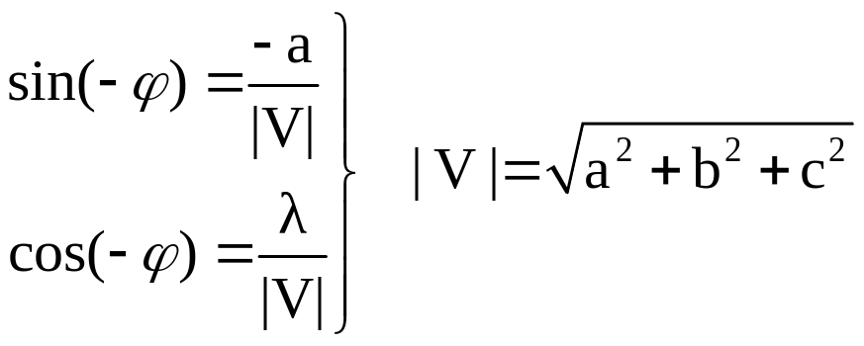
A_{V} : aligning vector V with k
z
Step 1: Rotate V about x-axis by θ
(0,0, λ)
(a,0, λ)
ϕ
Step 2: Rotate V about y-axis by −ϕ
|V|
y
A_{v} =
R_{-ϕ,j} *
R_{θ,i}
x

Slide 26
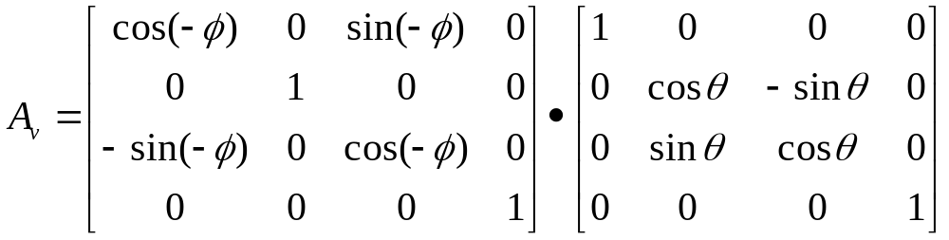
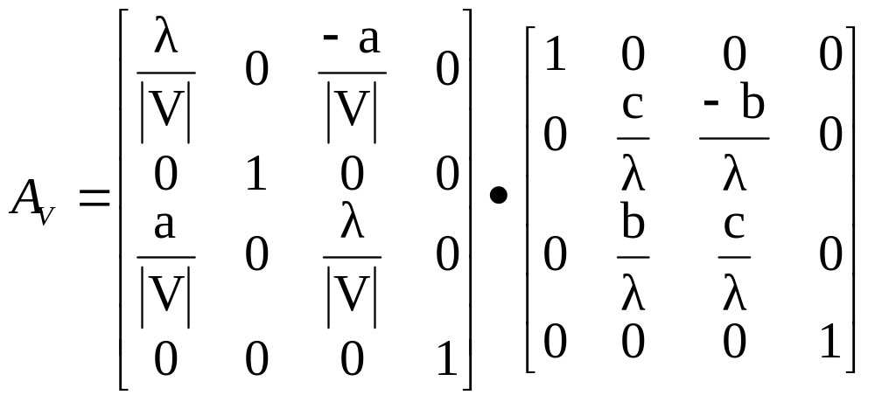
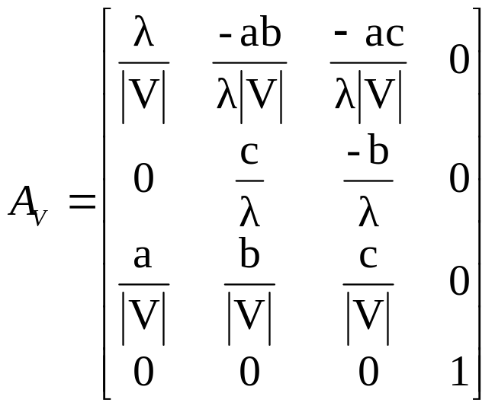
Av: Alignment transformation

Slide 27
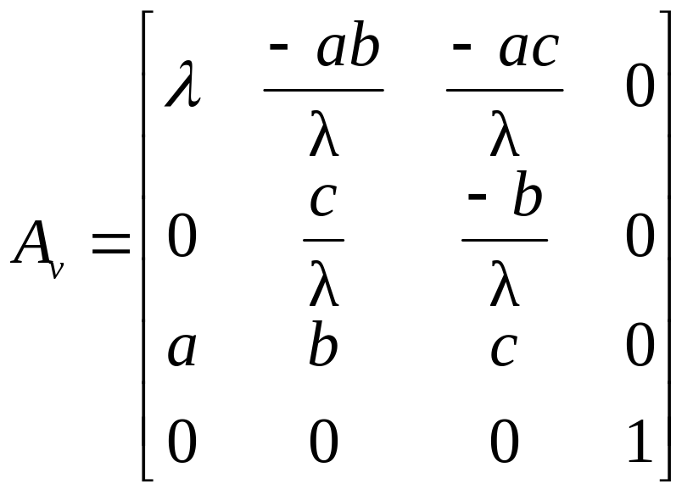
Av: Alignment transformation
If we normalize V = aI + bJ + cK to a unit vector v = aI +bJ + cK before rotation the matrix become simple enough
Where a = a / |V| b = b / |V| c = c / |V|

Slide 28
Inverse Alignment
Aligns the vector k with vector v

Slide 29
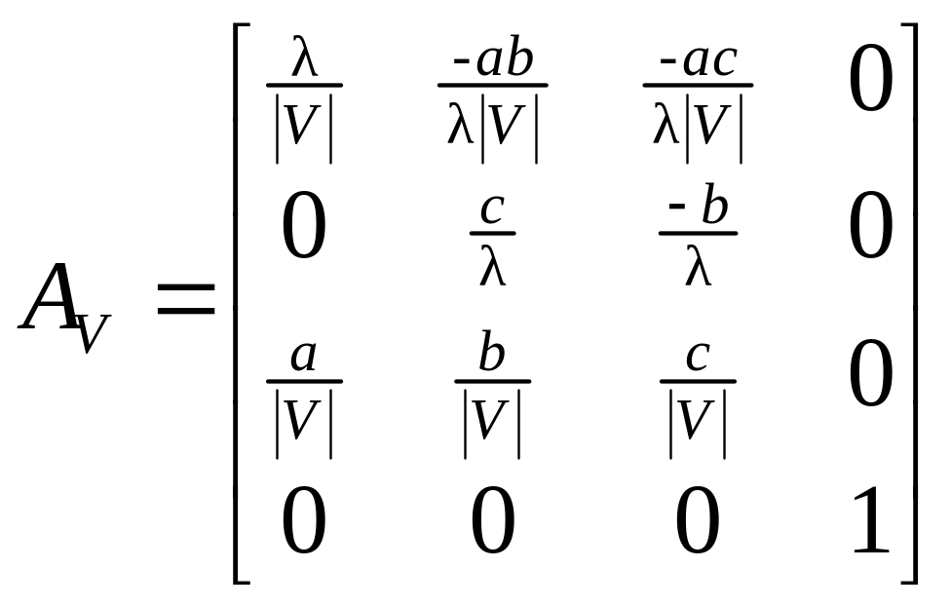
A_{V} : aligning vector v (V) with n (N)
A_{V}⁻¹ = A_{V}^{T}
A_{V,N} = A_{N}⁻¹ * A_{V}
z
V
N
k
y
x

Slide 30
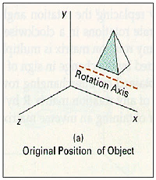
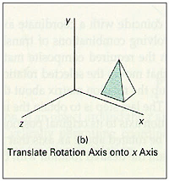
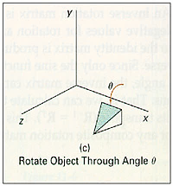
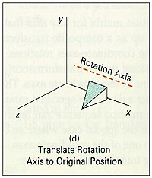
General 3D Rotations
Rotation about an Axis that is Parallel to One of the Coordinate Axes
  Translate the object so that the rotation axis coincides with the parallel coordinate axis
  Perform the specified rotation about that axis
  Translate the object so that the rotation axis is moved back to its original position

Slide 31
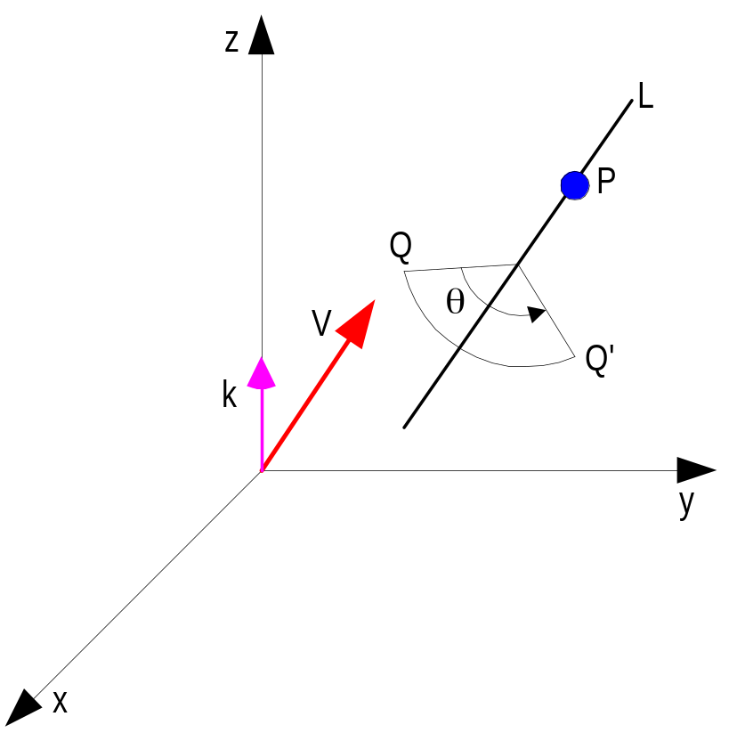
R_{θ,L} : rotation about an axis defined by line L
Let L be represented by vector V and passing through point P
Translate P to the origin
2. Align V with vector k
3. Rotate θ° about k
4. Reverse step 2
5. Reverse step 1
R_{θ,L} =
T_{-P}⁻¹ *
A_{V}⁻¹ *
R_{θ,k}*
A_{V} *
T_{-P}

Slide 32
R_{θ,L} : rotation about an axis defined by line L
Let, L be represented by two points P1 and P2
Then find V = P2 – P1, and use any one point as P
y
(x2,y2,z2)
(x1,y1,z1)
x
z
R_{θ,L} =
T_{-P}⁻¹ *
A_{V}⁻¹ *
R_{θ,k}*
A_{V} *
T_{-P}
= T_{P} * R_{α,i} * R_{β,j} *
R_{θ,k} * R_{-β,i} * R_{α,i} * T_{-P}

Slide 33
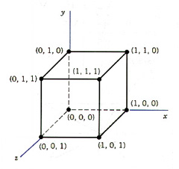
Example
Find the new coordinates of a unit cube 90º-rotated about an axis defined by its endpoints A(2,1,0) and B(3,3,1).
A Unit Cube

Slide 34
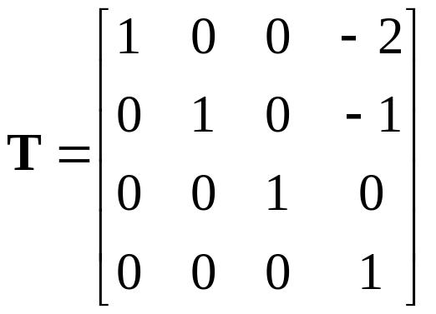
Example
Step1. Translate point A to the origin
y
B’(1,2,1)
A’(0,0,0)
x
z

Slide 35
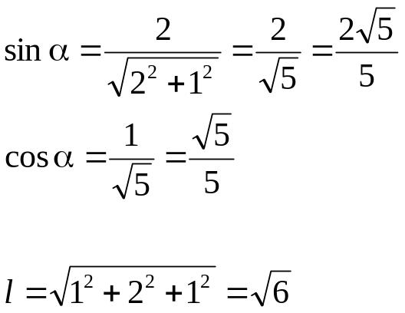
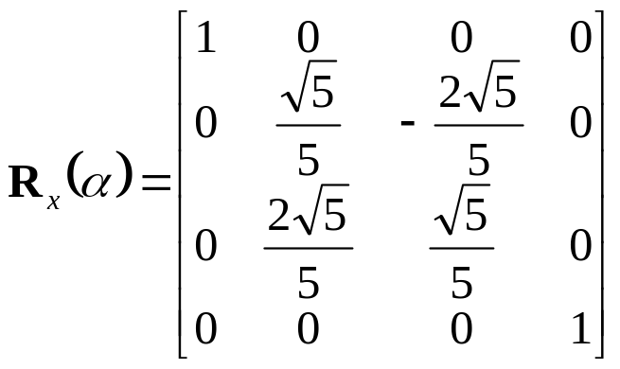
Example
Step 2. Rotate axis A’B’ about the x axis by and angle α, until it lies on the xz plane.
y
Projected point
(0,2,1)
B’(1,2,1)
α
l
x
z
B”(1,0,√5)

Slide 36
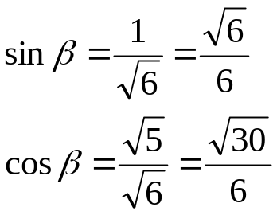
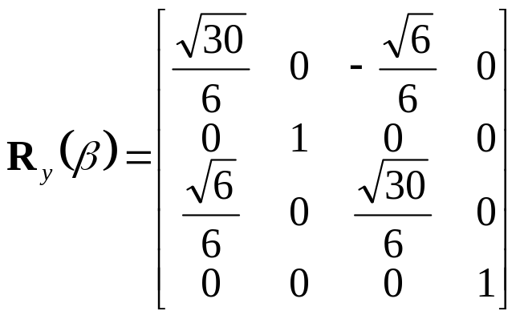
Example
Step 3. Rotate axis A’B’’ about the y axis by and angle β, until it coincides with the z axis.
y
l
x
β
(0,0,√6)
B”(1,0, √ 5)
z

Slide 37
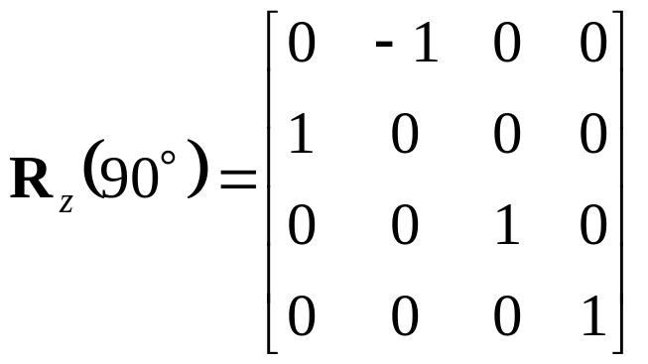
Example
Step 4. Rotate the cube 90° about the z axis
  Finally, the concatenated rotation matrix about the arbitrary axis AB becomes,

Slide 38
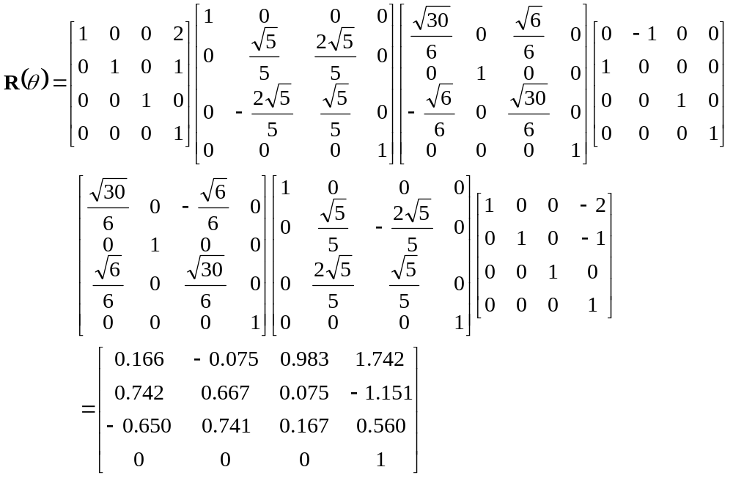
Example

Slide 39
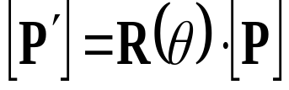
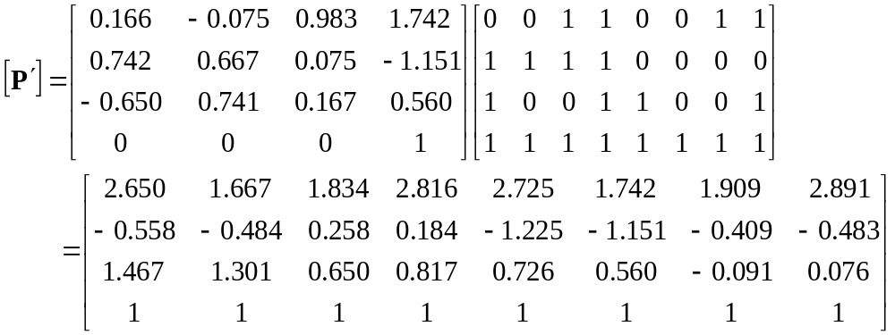
Example
Multiplying R(θ) by the point matrix of the original cube

Slide 40
Rotation using Quaternion

Slide 41
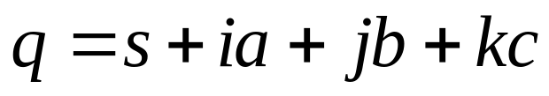
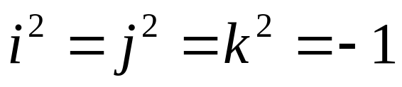
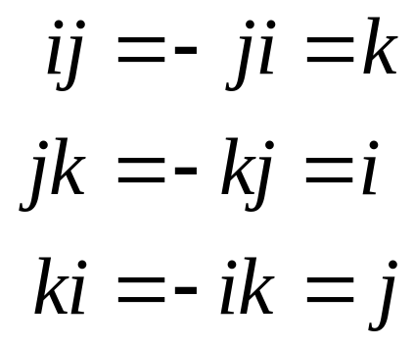
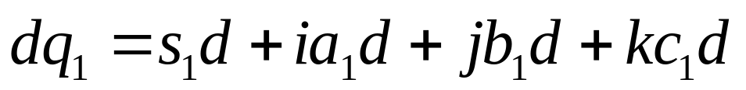
Quaternions
One Real Part + Three Imaginary Part
Properties:
Addition and Scalar Multiplication

Slide 42







Quaternions
Scalar ‘s’ + Vector “v = (x, y, z)”
Addition:
Multiplication
or
$$q^{−1}=\frac{1}{{\left|q\right|}^{2}}\left(s, −v\right)$$

Slide 43









Quaternions
Pure quaternion
Magnitude
Inverse
Conjugate
A unit quaternion has a magnitude equal to 1

Slide 44

3D Rotation with Quaternion
point P(x, y, z) is represented in quaternion form by
It can be shown that a position vector P is rotated through an angle θ about an axis using the following operation:
P′ = qPq⁻¹
  where the axis and angle of rotation are encoded within the unit quaternion q, and P′ is the rotated vector.
For example, to rotate a point P(x, y, z) an angle θ about an axis u, we use the following steps:
1. Convert the point P(x, y, z) to a pure quaternion P

Slide 45





3D Rotation with Quaternion
To rotate a point P(x, y, z) an angle θ about any axis u
Use the following steps:
  Convert the point P(x, y, z) to a pure quaternion or
  Define the axis of rotation as a unit vector ;
  Define the transforming quaternions q =[s + v] and q⁻¹ = [s – v]
  Compute P′ = qPq⁻¹ and unpack (x′, y′, z′)

Slide 46




Rotations with Quaternions
Carry out the quaternion operation
since

Slide 47



Rotations with Quaternions: Matrix form
Carry out the quaternion operation

Slide 48




Rotations with Quaternions : Matrix form
Since
=
Putting explicit values of q = (s, a, b, c), and apply following trigonometry

Slide 49



Rotations with Quaternions
Carry out the quaternion operation

Slide 50



Rotations with Quaternions

Slide 51
Rotations with Quaternions

Slide 52



Example
Rotation about z axis
  Set the unit quaternion:
  Substitute a=b=0, c=sin(θ/2) into the matrix:

Slide 53
Rotation about a Line using Quaternion
Let L be represented by vector V and passing through point P
Translate P to the origin
2. Use M_{R(θ)} for rotation
3. Reverse step 1
R_{θ,L} =
T_{P} *
M_{R(θ)} *
T_{-P}
i.e. M_{R(θ)} = A_{V}⁻¹ * R_{θ,k}* A_{V}
= R_{α,i} * R_{β,j} * R_{θ,k} * R_{-β,i} * R_{α,i}

Slide 54
DIY
Exhibit a unit quaternion that performs a rotation of 60 degrees about the axis 0,3,4 .
Further Study
Mathematics for Computer Graphics
  John Vince
Mathematics for 3D Game Programming and Computer Graphics
  Eric Lengyel

Slide 55
Mirror reflection
y
P(x,y,-z)
P(-x,y,z)
P(x,y,z)
x
P(x,-y,z)
z

Slide 56

Mirror reflection

Slide 57
M_{N,P} : Mirror reflection
Let the plane be represented by plane normal N and a point P in that plane
z
N
P
x
y
M_{N,P} =

Slide 58
M_{N,P} : Mirror reflection
Let the plane be represented by plane normal N and a point P in that plane
Translate P to the origin
z
N
P
x
y
M_{N,P} =
T_{-P}

Slide 59
M_{N,P} : Mirror reflection
Let the plane be represented by plane normal N and a point P in that plane
Translate P to the origin
z
2. Align N with vector k
N
P
x
y
M_{N,P} =
A_{N} *
T_{-P}

Slide 60
M_{N,P} : Mirror reflection
Let the plane be represented by plane normal N and a point P in that plane
Translate P to the origin
z
2. Align N with vector k
3. Reflect w.r.t xy-plane
N
P
x
y
M_{N,P} =
M_{xy} *
A_{N} *
T_{-P}

Slide 61
M_{N,P} : Mirror reflection
Let the plane be represented by plane normal N and a point P in that plane
Translate P to the origin
z
2. Align N with vector k
N
3. Reflect w.r.t xy-plane
4. Reverse step 2
P
x
y
M_{N,P} =
A_{N}⁻¹ *
M_{xy} *
A_{N} *
T_{-P}

Slide 62
M_{N,P} : Mirror reflection
Let the plane be represented by plane normal N and a point P in that plane
Translate P to the origin
N
z
2. Align N with vector k
P
3. Reflect w.r.t xy-plane
4. Reverse step 2
x
5. Reverse step 1
y
M_{N,P} =
T_{-P}⁻¹ *
A_{N}⁻¹ *
M_{xy} *
A_{N} *
T_{-P}

Slide 63

Other Transformations
Z-axis Shear

Slide 64









Further Composition
Translate points in fig. 1 into points in fig 2 such that:
  P₁ is at Origin
  P₁P₂ is along positive z-axis
  P₁P₃ lies in positive y-axis half of yz plane
The Composite Transform must have
  Translation of P₁ to Origin ⇒ T
  Some Combination of Rotations ⇒ R
y
y
y
T
R
x
x
x
z
Fig. 1
z
z
Fig. 2

Slide 65

Translate P₁ to Origin
Y
P₃
P₁
P₂
X
Z

Slide 66



Rotate about Y axis
So that P₁P₂ lies on yz palne
Angle = −(90º − θ)
Y
P₃’
P₁’
P₂’
D₁
Z
(
x
′
,
0
,
z
′
)
X
2
2

Slide 67


Rotate about X axis
- So that P₁P₂ lies on z axis
Y
P₃”
P₂”
Φ
θ
P₁”
Z
X

Slide 68
Rotate about Z axis
- So that P₁P₃ lies on yz palne
Y
α
P₃’”
Φ
P₁’”
P₂’”
X
Z

Slide 69

Finally
Y
α
P₃””
P₁””
P₂””
X
Z

Slide 70

Finding composite R (another way)

Slide 71



Finding R_{z}
y
R_{z}
x
z
R
y
x
z

Slide 72



Finding R_{x}
y
R_{z}
R_{x}
x
z
R
y
x
z

Slide 73



Finding R_{y}
y
R_{z}
R_{y}
x
z
R_{x}
R
y
x
z

Slide 74
So the composite matrix is M = R. T_{-p1}

Slide 75
Solve it
Consider a polygon with points P₁ (2,1,1), P₂(4,2,3) and P₃ (3,3,1). Find a composite transformation matrix to
1. Place the polygon in positive yz plane
2. Place P₁ at origin and P₁P₂ along positive z axis

Slide 76
Coordinate Transformations
Multiple Coordinate System
  Local (modeling) coordinate system
  World coordinate scene
Local Coordinate System

Slide 77
Coordinate Transformations
Multiple Coordinate System
  Local (modeling) coordinate system
  World coordinate scene
Word Coordinate System

Slide 78

Coordinate Transformations
Example – Simulation of Tractor movement
  As tractor moves, tractor coordinate system and front-wheel coordinate system move in world coordinate system
  Front wheels rotate in wheel coordinate system

Slide 79

Coordinate Transformations
Transformation of an Object Description from One Coordinate System to Another
Transformation Matrix
  Bring the two coordinates systems into alignment
  1. Translation
y’
y
u'_{y}
x’
y
u'_{y}
(x₀,y₀,z₀)
u'_{x}
u'_{x}
u'_{z}
(0,0,0)
x
z’
z
u'_{z}
(0,0,0)
x
z

Slide 80

Coordinate Transformations
  2. Rotation
y’
y
y
y
u'_{y}
x’
u'_{y}
u'_{y}
u'_{x}
u'_{x}
u'_{x}
(0,0,0)
x
(0,0,0)
x
(0,0,0)
x
z
u'_{z}
z
u'_{z}
z
u'_{z}
z’

Slide 81
Problems to be solved:
Schaum’s outline series:
Problems:
6.1
6.2, 6.5, 6.9, 6.10, 6.11, 6.12 ⇒ A_{v}
6.3, 6.4 ⇒ R_{θ,L}
6.6, 6.7, 6.8 ⇒ M_{N,P}
Acknowledgement
cgvr.korea.ac.kr

